Slide 1

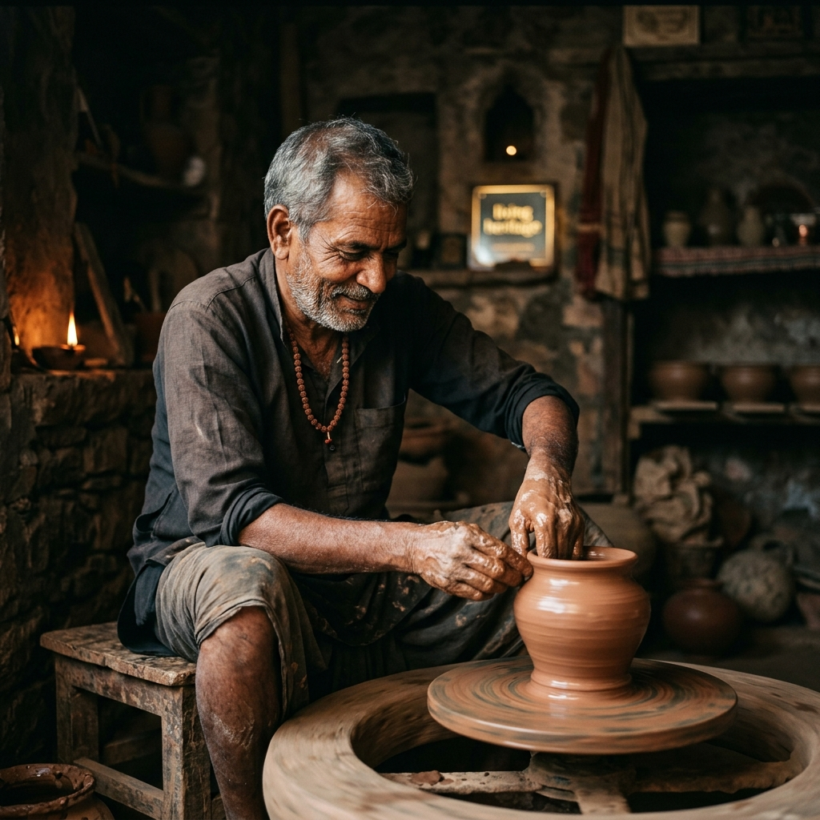
Parampara Heritage
One Country || One Masterpiece || Infinite Pride.
Discover the single most iconic handcrafted treasure from each of India's 28 states. Authenticity you can feel, heritage you can own
₹4.61 lakh crore
Heritage TAM
85%
Artisan Share
18% MoM
GMV Growth
6M+
Master Artisans

Slide 2
SLIDE 2 — THE ACUTE PAIN POINT
An Acute Heritage Crisis Demands Immediate Urgency
Global craft ecosystems suffer from severe exploitation, counterfeits, and loss of ancestral lineage.
800% Middleman Markups
Middlemen capture up to 90% of retail profit margins, leaving artisans under $3/day. 10,000+ artisans abandon crafts annually.
$15B Counterfeit Market
Cheap machine-made replicas swamping global markets impersonate authentic Geographical Indication (GI) heritage crafts.
Zero Digital Provenance
High-Net-Worth global collectors cannot verify authenticity or artisan lineage, creating deep mistrust in international markets.
CRITICAL URGENCY: Without direct digital fair-trade infrastructure, 40% of India's indigenous craft traditions will vanish within this decade.

Slide 3
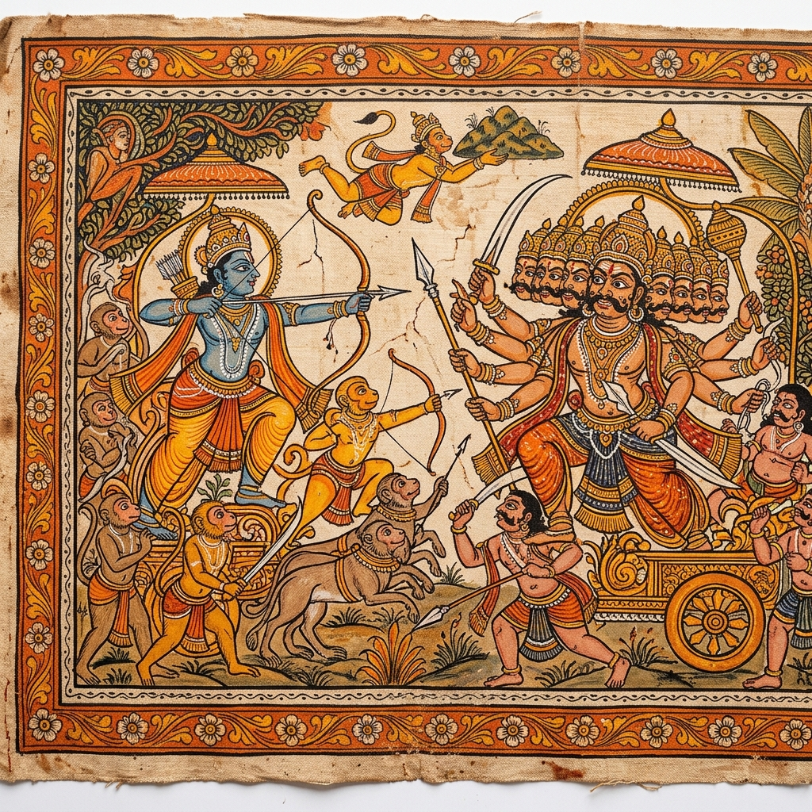
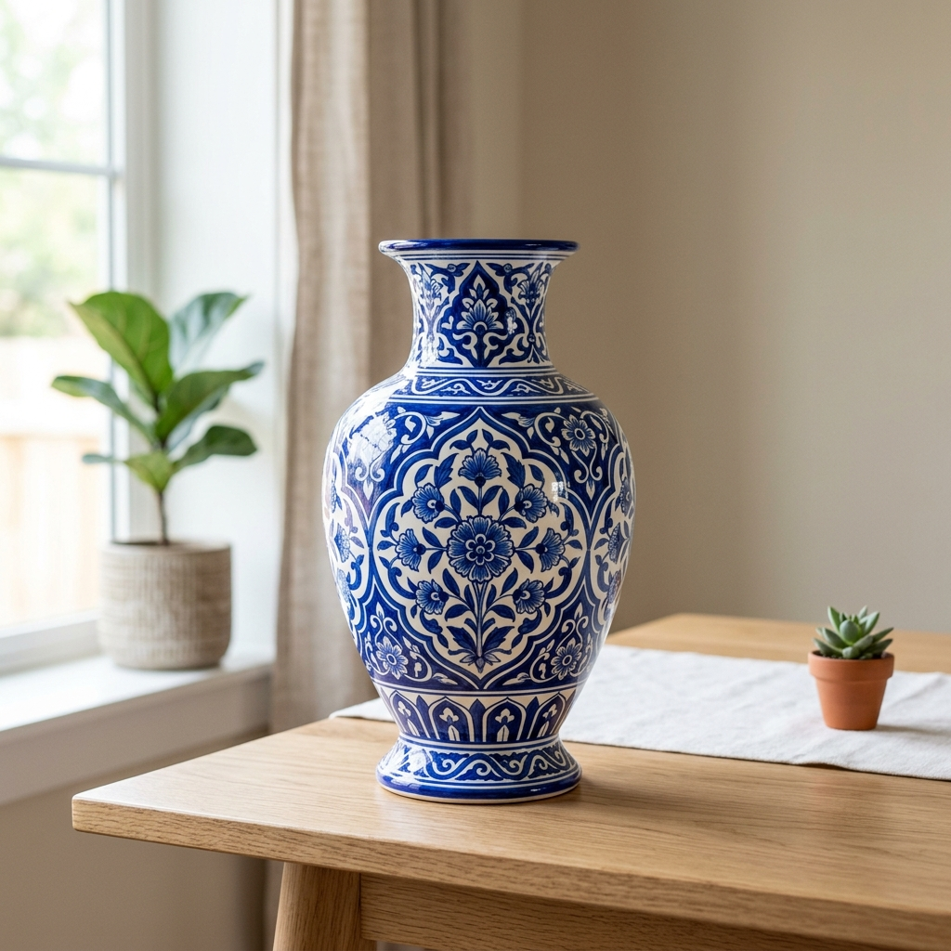
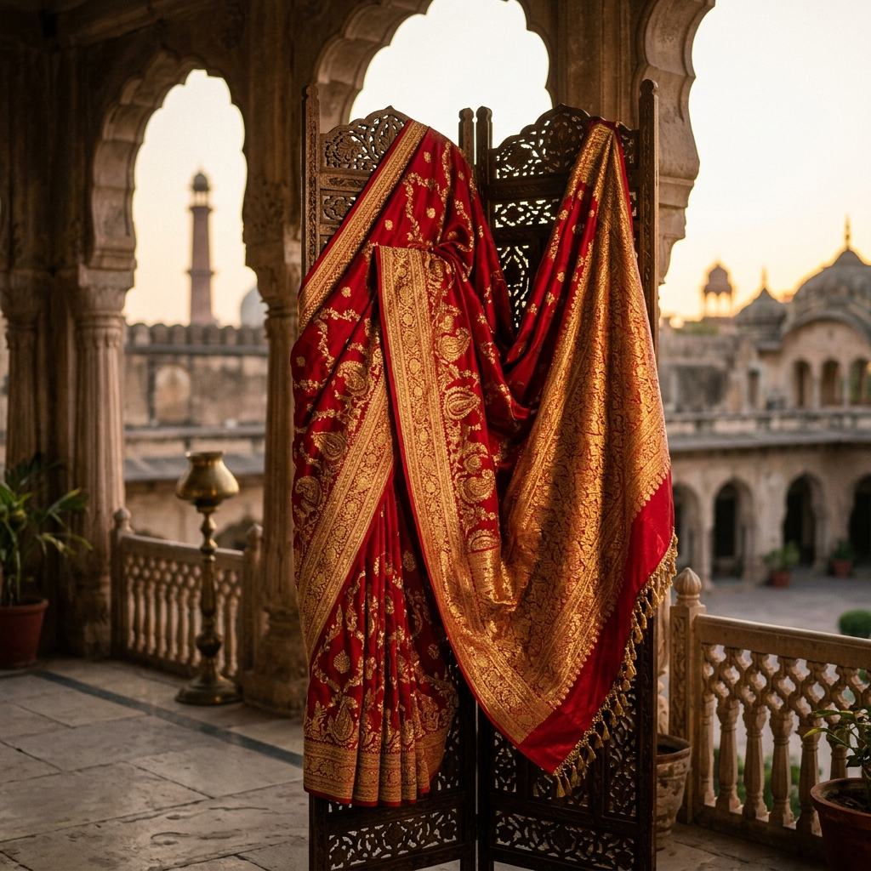
SLIDE 3 — PRODUCT SOLUTION & DEMO
The Parampara Platform & Provenance Engine
Direct artisan commerce paired with digital GI authenticity certificates and Gemini AI cultural storytelling.
✓ Direct-to-Artisan Payouts
Routes 85% of revenue straight to rural artisan bank accounts and co-ops.
✓ GI Certificate Generator
Cryptographically verifiable QR certificates shipped with every physical masterpiece.
✓ Gemini AI Concierge
Interactive AI guide bringing cultural history and craft lineage to life for buyers.
GEMINI AI CONCIERGE
"Pattachitra uses 100% natural stone pigments depicting Jagannath lore across 30 generations."
✓ Interactive State Map Engine
Real-time exploration of 28 Indian States & district craft density.

Slide 4
SLIDE 4 — BOTTOM-UP MARKET SIZE
$48.5 Billion Global Heritage Luxury Opportunity
Calculated bottom-up from target high-net-worth diaspora & global art collectors.
TAM (Total Addressable)
$48.5B
Global Handmade Heritage & Luxury Home Decor Market
SAM (Serviceable Addressable)
$3.0B
2.5M Global Diaspora & Collectors × $1,200 Annual Spend
SOM (Target Year 3)
(Serviceable Obtainable Market)
$120M
150,000 Active Luxury Buyers × $800 Annual Contract Value
BOTTOM-UP SOM FORMULA:
SOM = 150,000 Target Luxury Collectors × $800 Annual Contract Value (ACV) = $120,000,000 (Target Year 3)

Slide 5
SLIDE 5 — BUSINESS MODEL & MONETIZATION
Multi-Stream Revenue Engine with High Unit Economics
Diversified monetization spanning direct D2C commissions, B2B SaaS co-op fees, and corporate gifting.
Marketplace Stream
15% Take-Rate
Direct platform commission on consumer transactions across luxury heritage crafts and certified masterpieces.
Co-Op SaaS Tier
₹28,400 - ₹95,100/month
Subscription inventory OS & digital storefronts for GI Cooperatives and Export Guilds.
Corporate Gifting
25% - 35% Margin
B2B bespoke artisan commissions for luxury hotel chains, diplomatic events, and corporate gifts.
Customer Acquisition Cost (CAC): ₹40,000
Blended CAC across targeted paid search, cultural events, and heritage D2C.
Customer Lifetime Value (LTV): ₹2,28,400
5.7x LTV/CAC Ratio with high repeat purchasing among art collectors.

Slide 6
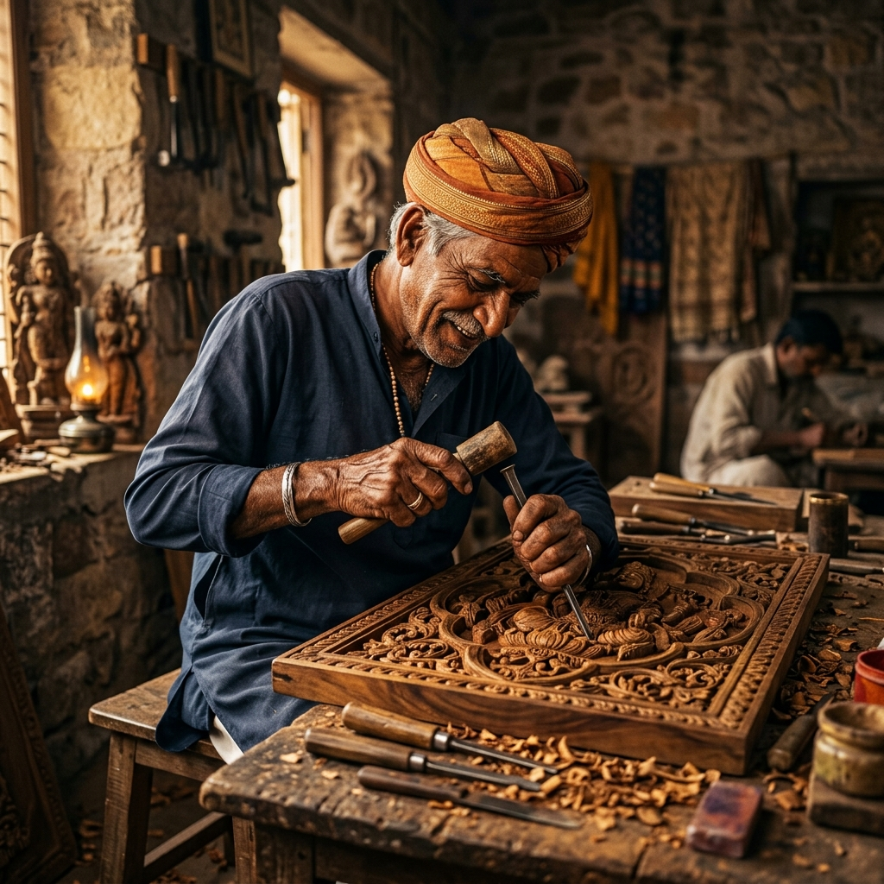
SLIDE 6 — TRACTION & KEY GROWTH METRICS
Month-over-Month Growth Driven by Authentic Provenance
Demonstrated demand avoiding vanity metrics in favor of organic GMV and artisan retention.
MONTH-OVER-MONTH TRACTION HIGHLIGHTS
28 Indian States Traditional crafts from all 28 states of India are represented on the platform.
70% Revenue to Artisans 70% of revenue is directed to artisans, helping reduce dependence on middlemen.
Heritage Certified Products Each product is supported by a Digital Certificate of Authenticity.
Master Artisan Profiles Artisans get a digital identity showcasing their craft, experience, awards, and achievements.
Global Customer Reach Parampara connects Indian artisans with customers worldwide through an e-commerce platform.

Slide 7
SLIDE 7 — TECH STACK & EDGE ARCHITECTURE
High-Efficiency Architecture & AI Storytelling Engine
Microservices architecture delivering sub-100ms API responses and domain-tuned AI context.
EDGE & CLIENT LAYER
HTML5 & SVG Map Engine
Zero-dependency client architecture, responsive SVG state maps, glassmorphism UI.
BACKEND API LAYER
Node.js + Express 5
RESTful API services, JWT security, webhooks for Razorpay & Stripe payments.
DATA & MEDIA ENGINE
MongoDB Atlas & Cloudinary
Cloud MongoDB cluster with WebP image optimization and video delivery CDN.
AI INTELLIGENCE
Gemini 3.6 API
Domain-tuned cultural heritage storyteller & automated GI certificate generator.
⚡ INFRASTRUCTURE ADVANTAGE: 99.99% Uptime | Sub-100ms Response Times | Complete Data Sovereignty

Slide 8
SLIDE 8 — COMPETITIVE QUADRANT & MOAT
Why Parampara Outperforms Mass Retailers & Legacy Galleries
Combining high digital scalability with verified digital craft provenance.
COMPETITIVE POSITIONING QUADRANT
• PARAMPARA (Winner Top-Right): High Digital Scale + Direct Verified GI Provenance.
• Mass E-Commerce (Etsy/Amazon): High Scale, but Low Provenance (Fake crafts, exploited sellers).
• Legacy Art Galleries: High Provenance, but Low Scale (500% markup, zero digital reach).
• Local Craft Fairs: Low Scale, Low Reach (Seasonal, local only).
OUR DEFENSIBLE MOATS
1. Exclusive Co-Op Contracts:
Multi-year binding contracts with 30+ official Indian Geographical Indication (GI) guilds.
2. Digital GI Verification Engine:
Proprietary serial code & QR cryptographic certificate linked directly to artisan IDs.
3. Domain-Tuned Cultural AI:
Custom Gemini knowledge base trained on 5,000+ authentic heritage documents.

Slide 9
SLIDE 9 — LEADERSHIP & TEAM
Built by Engineering & Heritage Preservation Leaders
Combining deep technical execution with authentic artisan guild leadership.
Pruthviraj
Full-Stack Developer
Responsible for overall application development and integration.
Renukaradya M B
Frontend Developer
Responsible for UI/UX, website pages, responsive design and frontend implementation.
C R Suchith
Backend Developer
Responsible for Node.js, Express.js, REST APIs and backend logic.
Manikanta K Poojar
Database Developer
Responsible for MongoDB, Mongoose, database schema and data management.

Slide 10
